Slide 1


Machine Learning for chemical and Engineering Sciences
Computational Chemistry Lab - Department of Chemistry -KNUST
Department of chemistry, KNUST

Slide 2

What is Machine Learning?
Machine learning is a subfield of artificial intelligence that uses algorithms trained on data sets to create models capable of performing tasks that would otherwise only be possible for humans, such as categorizing images, analyzing data, or predicting price fluctuations.

Slide 3
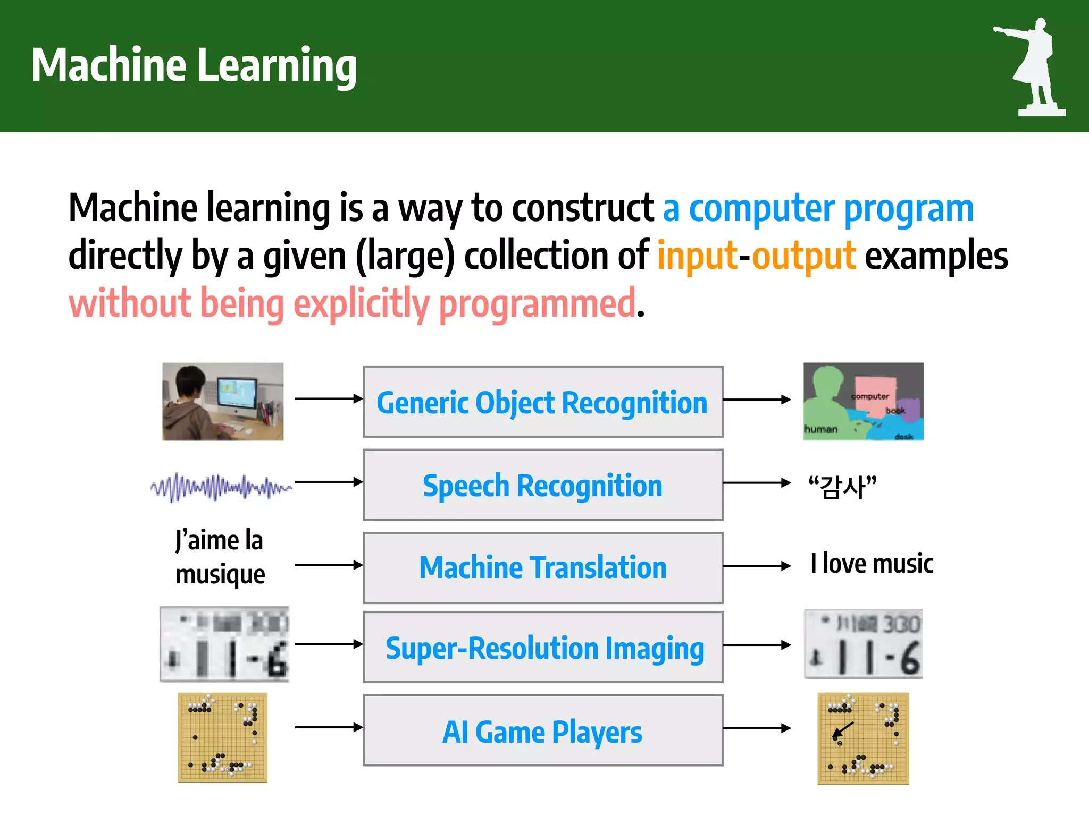
What is machine learning?

Slide 4

How do machines learn?
Data storage
(Inputs)
Brain type
(Model selection)
Feedback
(Test and Improve)
Training
(learning, analysis)

Slide 5
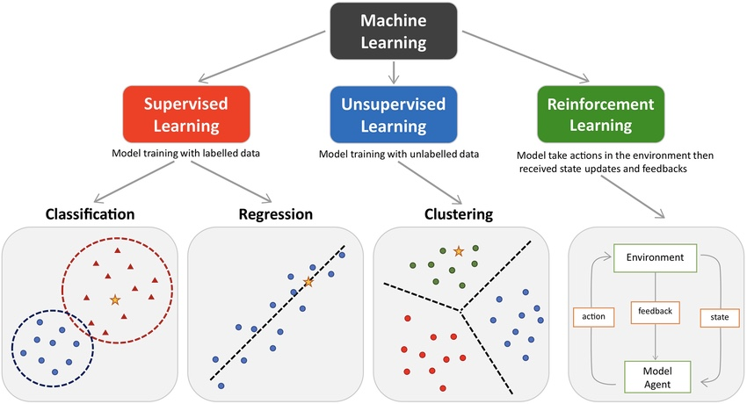
Main types of machine learning
Mapping
Classes
Action

Slide 6
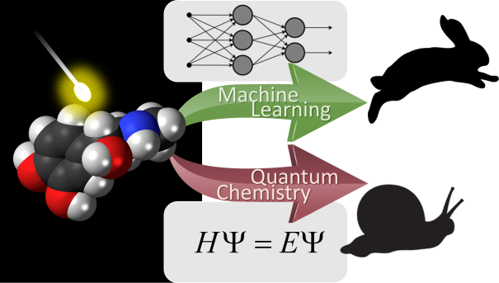
Why ML is relevant in Chemistry?
Faster drug screening
Aids in material design
Data driven insights
Enhance computational chemistry
Automated labs
Reaction prediction and automated synthesis
Faster and Cheaper

Slide 7
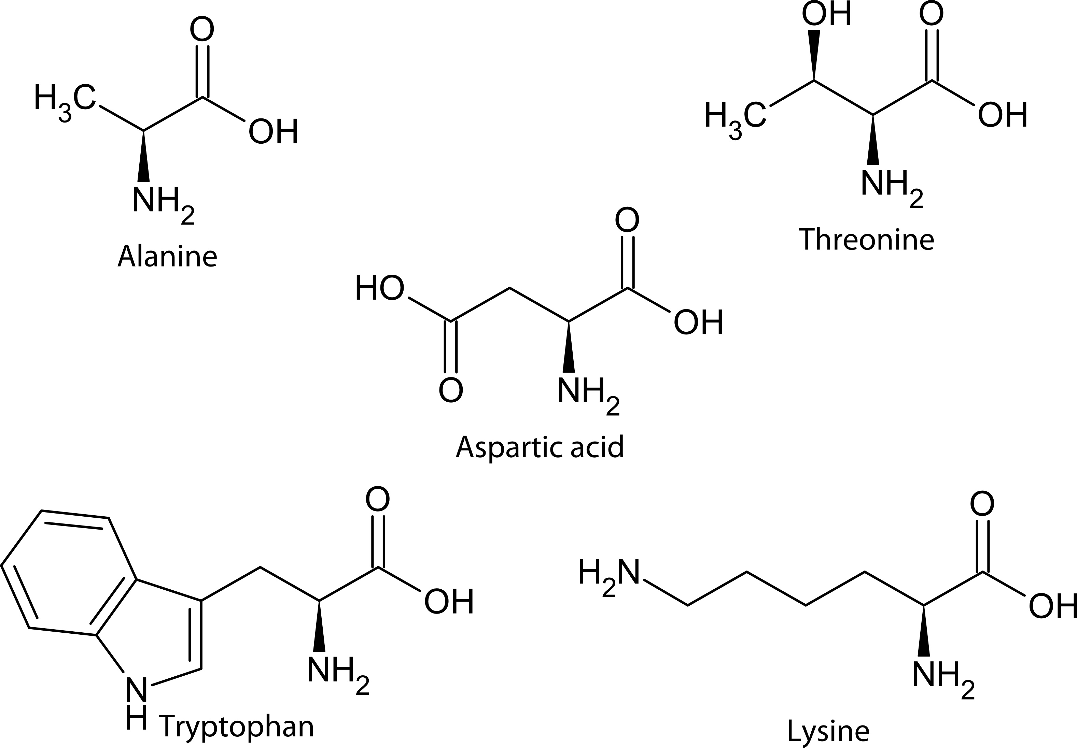
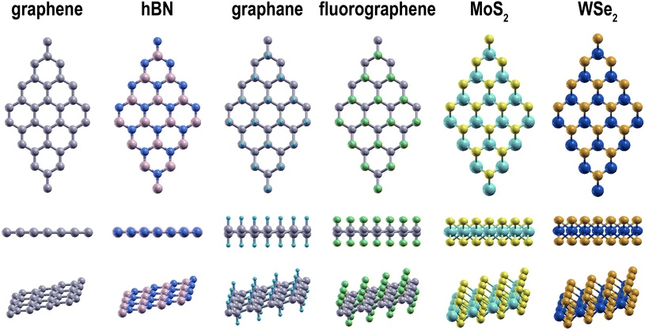
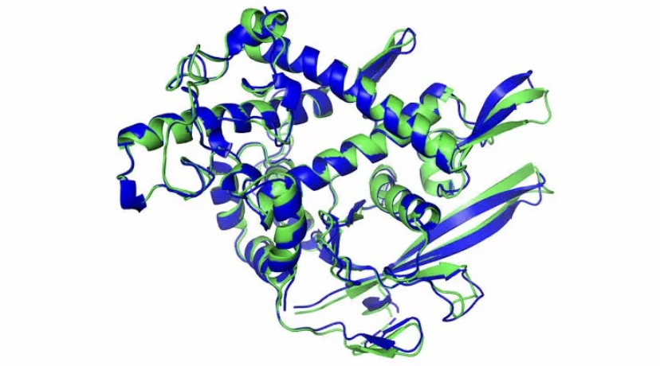
Data representation
Machines do not learn with chemical structures or names:

Slide 8
Data representation
The machines only understands numbers, so data must be encoded from chemical space into numbers
The process of converting chemical structures to descriptors is termed “Featurization”
In chemical sciences, moleculer data is often represented in the following formats:
SMILES
CIF
.out Files
XYZ files
InChI
Spectral data
others

Slide 9
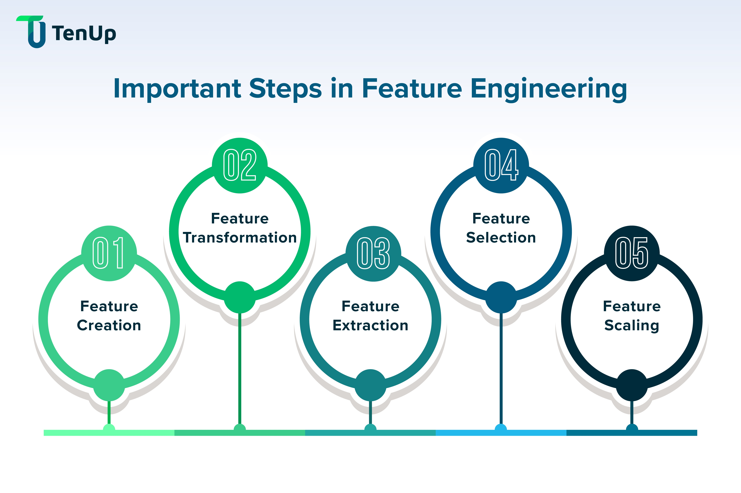
Feature Engineering
The process of using domain knowledge to select, extract, transform and create features or descriptors from raw data to improve the performance of ML model.
Tools: RDkit, Matminer, ASE,etc.

Slide 10
Supervised Machine Learning for Chemical prediction
Algorithms learns from chemical data with known outcomes
Used for property prediction and classification
The outcome could be:
  Continuous value (Regression):
  Example: adsorption energy, formation energy, solubility
  Categorical (Classification):
  Example: toxic or non-toxic, acidic or basic, active or inactive

Slide 11
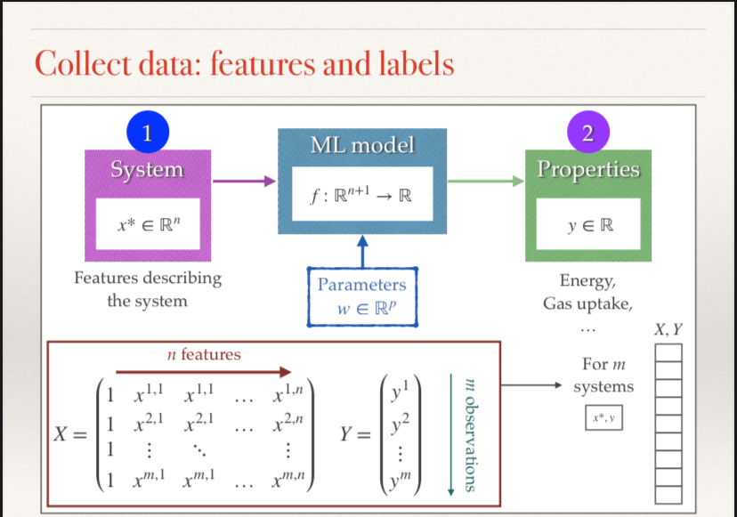
Supervised machine learning for chemical prediction

Slide 12
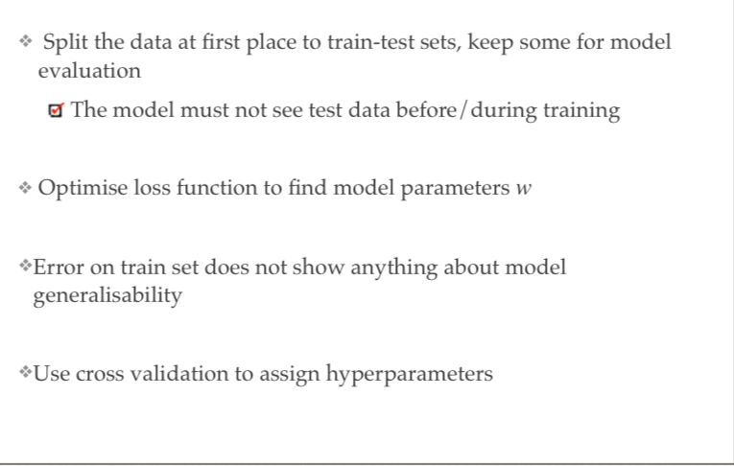
Summary of model training

Slide 13
Regression and classification algorithms
Both are supervised ML techniques used in prediction
Regression
  Regression fines the best line of fit to minimize error.
  It is use to predict continuous value based on input data
Classification
  classification algorithms categories data using decision boundary to minimize classification errors
  It is use to classify data points

Slide 14
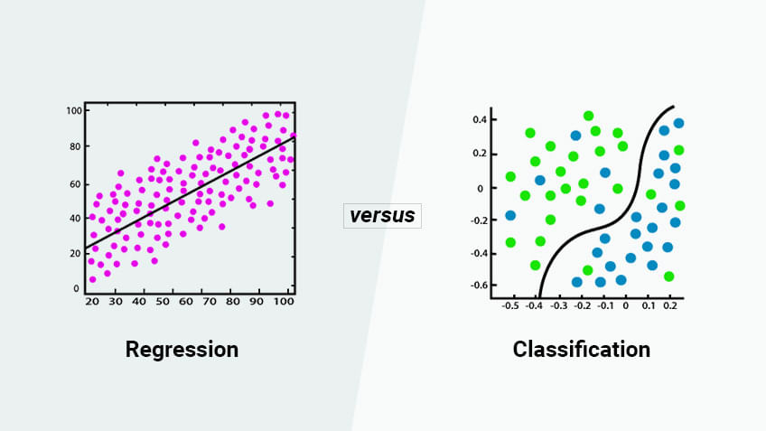
Regression and classification algorithms

Slide 15
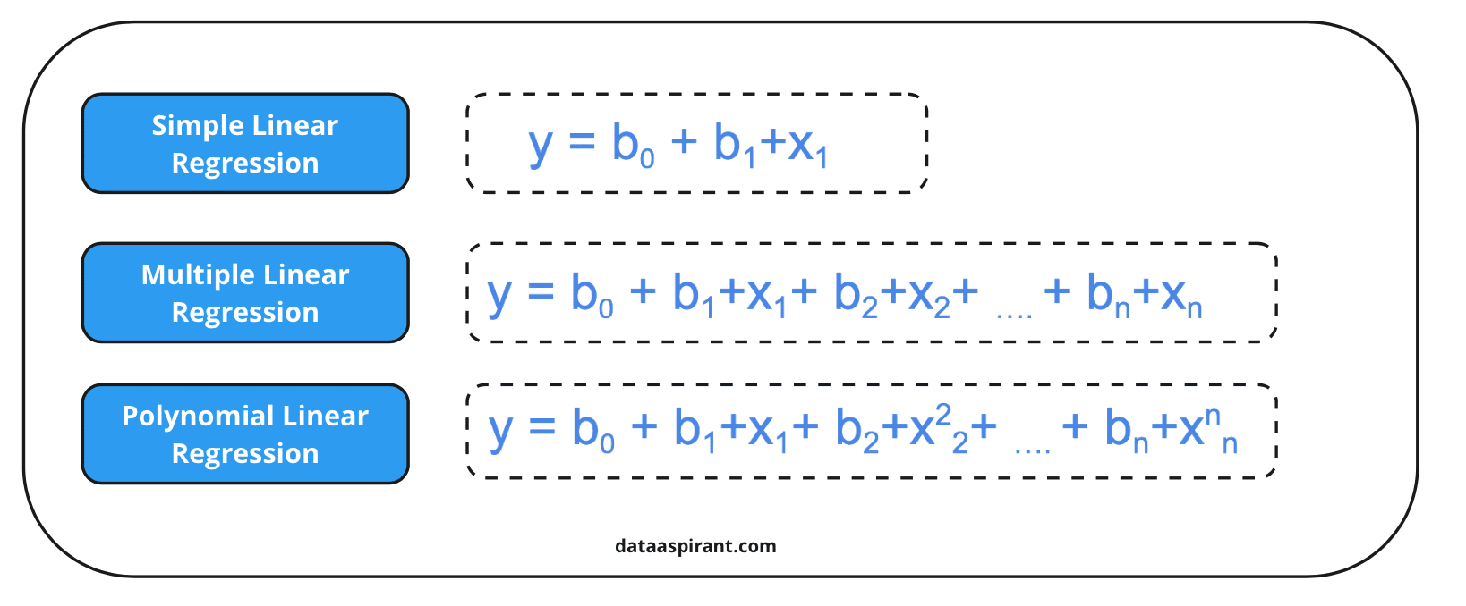
Types of Regression

Slide 16
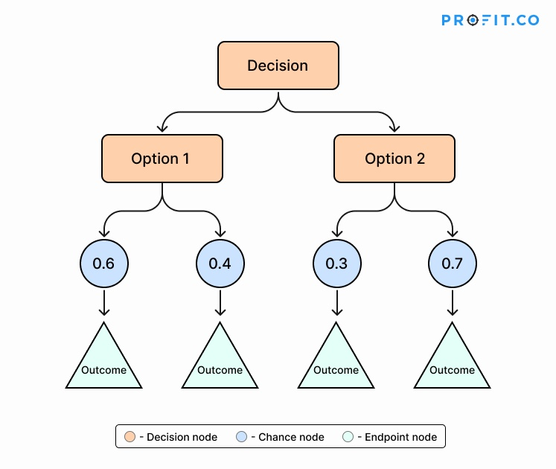
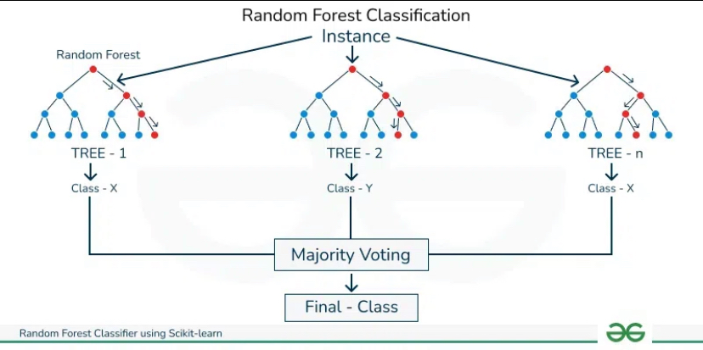
Classification Algorithms
1. Decision Trees
2. Random forest

Slide 17
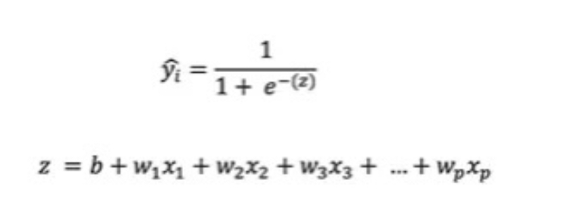
Classification Algorithms
3. Logistic Regression

Slide 18
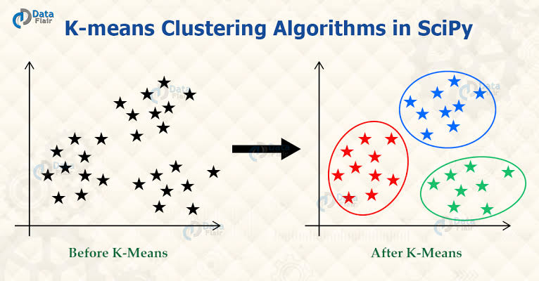
Unsupervised learning and pattern recognition
No labels - model finds hidden patterns in data
usually comes before supervised learning
  common methods include:
    Clustering (K- means)
    Dimentionality reduction (PCA)
  Used for:
    Grouping similar compounds
    Detecting anomalies in chemical space

Slide 19
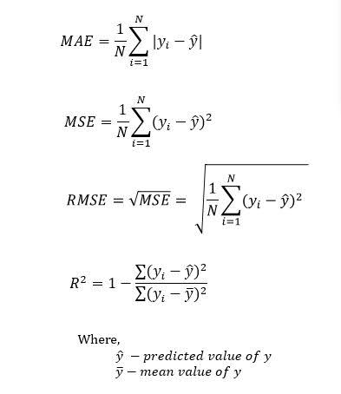
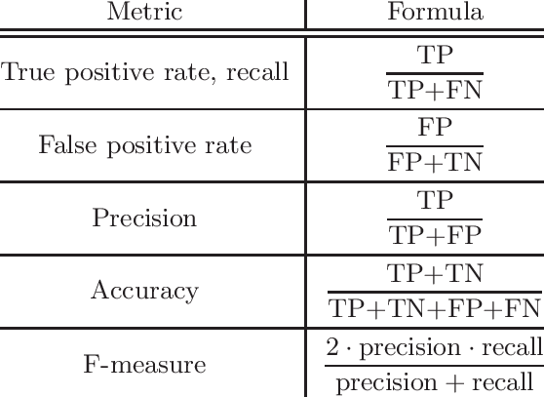
Model Evaluation and Validation
Regression evaluation metrics
Classification evaluation metrics

Slide 20
Model Evaluation and Validation
The purpose of validation is to ensure our trained model generalizes well on new unseen data
To prevent overfitting and underfiting
The most common cross-validation method is:
  K-Fold cross-validation
    Divide the data into k equal folds.
    Train the model on (k-1) folds.
    Test on the remaining fold
    Repeat k times, each time with different test fold
    Take the average performance across all folds

Slide 21
Application in computational chemistry
Property Prediction
Accelerating QC calculations:
  Example; Delta-learning
Molecular and Material design: Google AlphaFold 3
Faster screening
Reaction prediction

Slide 22
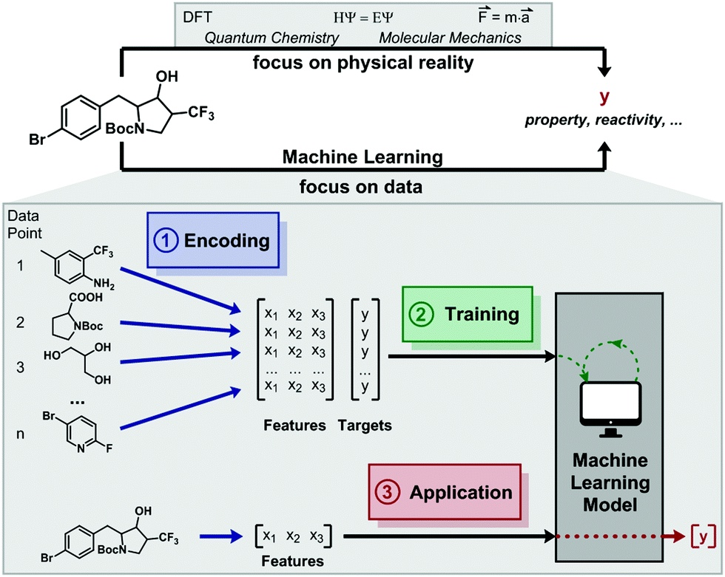
Application in computational chemistry

Slide 23
Application in computational chemistry
Sample project:
Predicting the Fermi Level of Transition Metal-Doped Iron Surfaces Using Machine Learning.
next slides....

Slide 24
Coding session....

